Slide 1

Hair Product Sales Analysis (Jan - Jun 2024)
BY OLAMIDE BADUSI

Slide 2

Table of Contents
About
Project Overview
Data Exploration
Analysis & Insights
Recommendations
Conclusion
Appendix

Slide 3

ABOUT
In the world of beauty and hair extensions, consumer preferences are constantly influenced by evolving trends, seasonal demands, cultural events, and broader economic conditions. The hair extension industry sees fluctuations as demand for specific styles, colors, and products rise and fall in response to these external factors. Similarly, economic changes can impact how much consumers are willing to spend on hair products.
To better understand how these factors affect their business, this analysis focuses on Solpia Nigeria Ltd., a leading provider of premium-quality hair extensions Solpia offers a wide range of products that cater to diverse beauty needs, but like others in the hair industry, their sales performance can be shaped by external influences such as seasonal trends and event-driven purchasing patterns.

Slide 4

Project Overview
In this analysis, I looked into the sales patterns of various hair products from Solpia Nigeria Ltd. using Power BI, focusing on key metrics such as the number of products available in each color, total sales, and the volume of cartons sold. This study provides insights into customer preferences and the factors influencing sales performance across different hair product variants.

Slide 5

Aim
Identify the best-selling products and color variants across the first half of 2024.
Analyze how seasonal impact consumer purchasing behavior.
Evaluate the effectiveness of product offerings and suggest inventory optimization strategies to ensure high-demand products are readily available.
Provide insights that help Solpia align its marketing and sales strategies with customer preferences during peak periods.

Slide 6
Methodology
The analysis was conducted using sales data from January to June, with a specific focus on identifying trends based on color variations. Power BI was used to create visualizations, such as bar charts and line graphs, to track the performance of each product color. Key data points analyzed include the number of products available per color, total sales, total cartons sold, and the relationship between product availability and sales performance.

Slide 7

Data Exploration
Dataset Source: The dataset used for this analysis contained detailed sales records of various hair products, including the product names, color variants, the number of cartons sold, and sales figures over a six-month period from January to June.

Slide 8

Data Cleaning Procedure
Before the analysis, the dataset required some cleaning to ensure accuracy and consistency. Here are the steps I followed: - Removing Duplicates: I first checked for and removed any duplicate entries to avoid skewed results. - Handling Missing Data: Any missing values in critical columns like product names, colors, or sales figures were either filled in based on logical assumptions or removed if deemed irrelevant. - Standardizing Formats: I standardized the format of product names and color labels to maintain consistency across the dataset. - Creating Additional Columns: I added calculated columns to capture metrics such as total sales per color, the number of products per color, and monthly sales trends.

Slide 9

Importing into Power BI
Once the dataset was cleaned, it was imported into Power BI for analysis:
Importing Data: Used the 'Get Data' feature to load the cleaned dataset from an Excel file.
Data Modeling: Structured the data into relevant tables and established relationships.

Slide 10

OVERALL SUMMARY
Total Cartons Sold: 2 million cartons
Total Sales: $6 billion
June saw the highest sales, with 556,000 cartons sold (34.31% of the total).
Top-Selling Products: Wow Braid, Pop Braid, and Glossy Braid.
Least-Selling Products: Jamaican Locs and Bahama Locs.

Slide 11
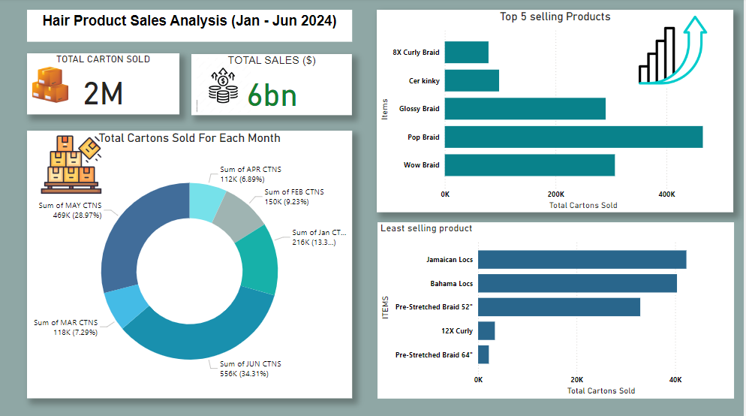

Slide 12
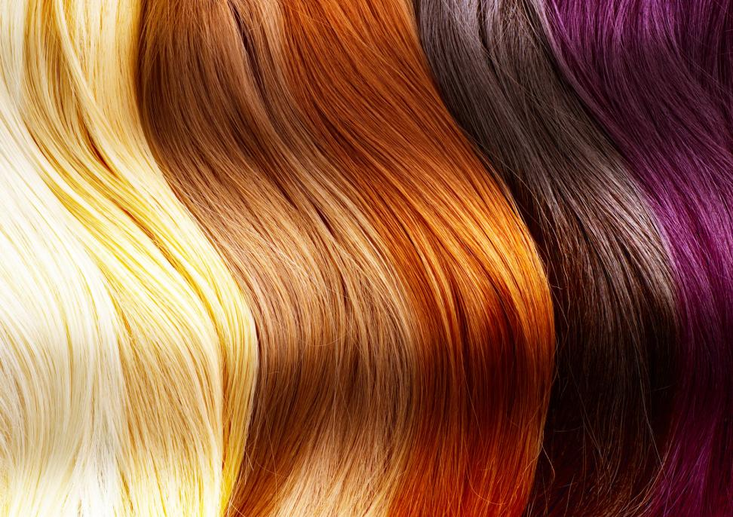
Product-Color Relationship
Top Colors: Colors like 30, 1, and 27 dominate the market, contributing significantly to sales volume.
Least Colors: Colors like 1/39, Sangria, T-Blue, and 1/BG are among the least popular, each selling fewer than 8,000 cartons.
Total Colors: Across the product range, there are a total of 53 distinct color variations available.
Product with Most Colors: Pop Braid and Wow Braid offer the highest number of color variants, with 42 and 32 colors respectively, making them highly versatile products appealing to a broader audience.
This Photo by Unknown Author is licensed under CC BY-ND

Slide 13

Analysis & Insights
Total Cartons Sold: 2 million cartons were sold between January and June 2024.
Total Sales: The sales value reached $6 billion, indicating a high revenue per unit sold, potentially reflecting a premium pricing strategy for certain products.
Monthly Sales Distribution: - June saw the highest sales, with 556,000 cartons sold (34.31% of the total). This spike in sales likely coincides with the Salah festival, indicating that cultural or seasonal events significantly boost sales. - May followed with 469,000 cartons sold (28.97%), which could suggest early purchasing ahead of the June festivities. - January with 216,000 cartons sold (13.34%) to the overall sales, suggesting restocking after Christmas sales.

Slide 14
INSIGHTS
Dominance of Specific Products: - Pop Braid and Wow Braid are the standout products, leading in both sales revenue and volume of cartons sold. Their success is likely driven by a broad range of color options and strong market demand. These products should be central to marketing and sales strategies, especially during peak seasons. Importance of Color Variants: - Products with a wider range of color variants tend to perform better in the market. Color 1, 30, and 27 are particularly popular across multiple products, contributing significantly to sales volume. This suggests that color availability is a critical factor in customer purchasing decisions. Sales Trends by Month: - Sales are not evenly distributed throughout the months. The data shows a peak in sales during certain months, such as June, which suggests that these periods are critical for maximizing revenue. Understanding these trends can help in planning production, inventory, and marketing efforts more effectively.

Slide 15

Insights: Product Performance
Product Performance: The best-selling products are likely driving the majority of the revenue. Focused marketing and inventory strategies on these products could yield higher returns. However, attention should also be given to the least-selling products to understand why they underperformed—this could involve reassessing pricing, marketing strategies, or even product design. Product Variants: Variants like Pre-Stretched Braid and Locs may need targeted promotions or might be more successful in different markets or seasons. Understanding the specific demographics or regions where these products might perform better could help in repositioning them.

Slide 16
Recommendations
Sales Seasonality
The significant increase in sales during May and June underscores the impact of seasonal events on consumer behavior. Aligning marketing and inventory strategies with cultural and seasonal events should be encouraged to maximize sales.

Slide 17
Recommendations
Focus on best-selling products like Pop Braid and Wow Braid for higher returns.
Reevaluate underperforming products (e.g., Jamaican Locs, Bahama Locs) and target niche markets.
Expand color options for mid-tier products like 8X Curly Braid to capture more market share.
Ensure top-selling products are well-stocked during high-demand periods to optimize sales performance.

Slide 18

Conclusion
This analysis reveals that success in the hair product market is influenced by the variety of color options and alignment with consumer demand. By focusing on expanding color options for mid-tier products, improving marketing for niche products, and aligning strategies with seasonal sales peaks, Solpia can boost overall performance.

Slide 19
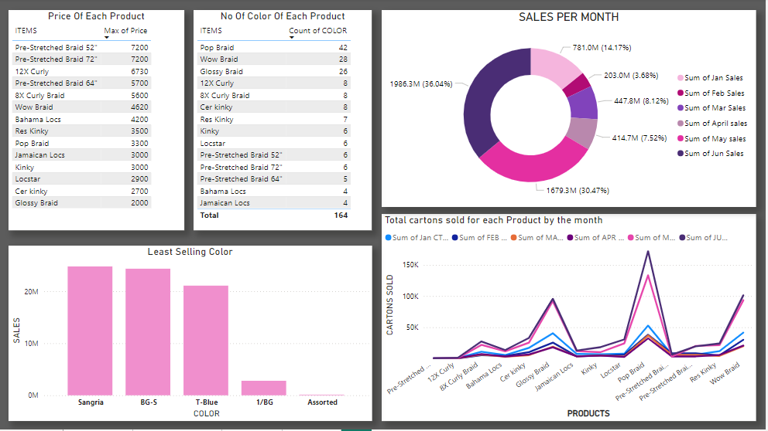
Appendix

Slide 20
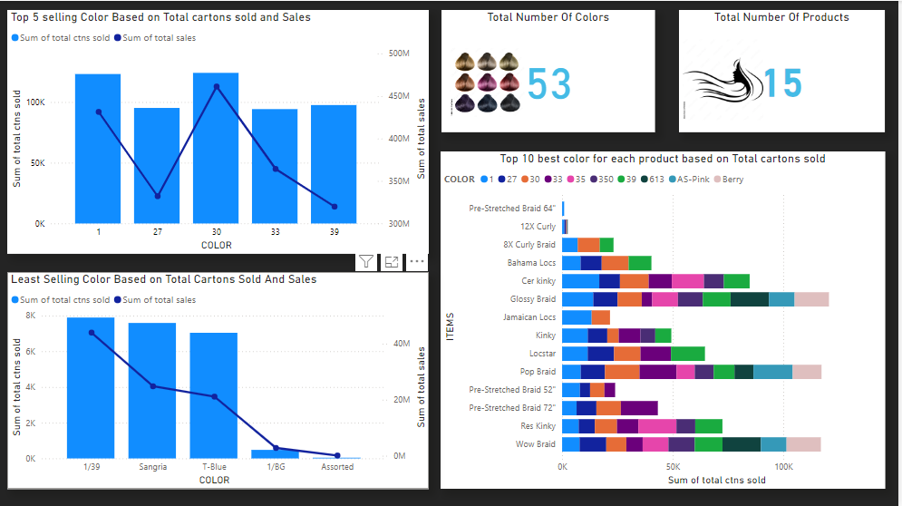

Slide 21
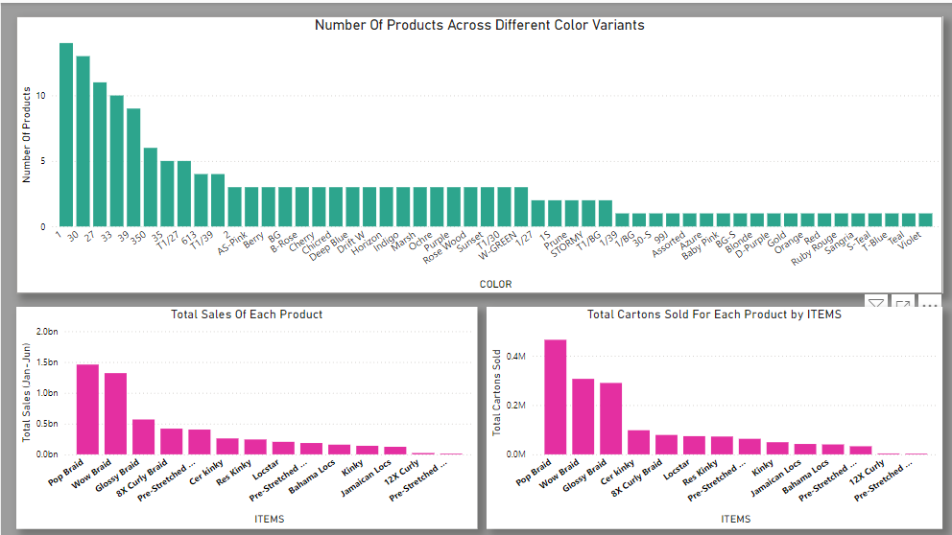

Slide 22

THANK YOU
Contact me via LinkedIn https://www.linkedin.com/in/olamide-badusi-2695ab278/ or email BADUSIMIDE@GMAIL.COM Visit my MEDIUM LINK https://medium.com/@badusimide

